Slide 1
2015 Traffic Fatalities
Aren Gharabeiki
500404715

Slide 2
Background Studies
A multivariate regression analysis was performed to determine the factors that lead fatalities in motor vehicle collisions with cyclists (Czech Rep.)
It was determined that the biggest factors of fatalities are speeding motor vehicles, head-on crashes and night-time traffic in poorly-lit areas
In another study, it was hypothesized that alcohol intoxication leads to different accidental kinematics, a higher injury severity score
38,000 road accidents between 1999-2010 were evaluated
More than 20 000 patients were injured, and 2.3% were killed. Among the killed, 2.2% with negative BAC were killed, compared to 4.6 % for patients with a positive BAC. Alcohol intoxication leads to a higher preclinical mortality and higher injury severity.
Bíl, M., Bílová, M., & Müller, I. (2010). Critical factors in fatal collisions of adult cyclists with automobiles. Accident Analysis & Prevention,42(6), 1632-1636. doi:10.1016/j.aap.2010.04.001
Stübig, T., Petri, M., Zeckey, C., Brand, S., Müller, C., Otte, D., Haasper, C. (2012). Alcohol intoxication in road traffic accidents leads to higher impact speed difference, higher ISS and MAIS, and higher preclinical mortality. Alcohol, 46(7), 681-686. doi:10.1016/j.alcohol.2012.07.002

Slide 3
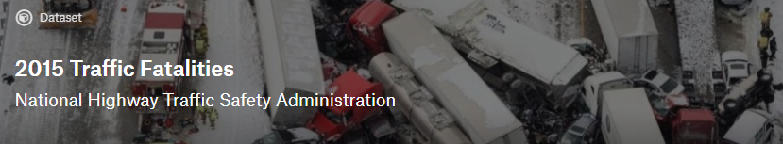
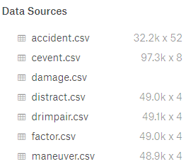
Dataset
Www.Kaggle.com
Used accident.csv data

Slide 4
Questions
How many accidents with x amount of people involved?
How many fatalities per accident?
Fatalities per state
Weather effects on fatalities
Can the number of fatalities be predicted based on certain attributes?

Slide 5
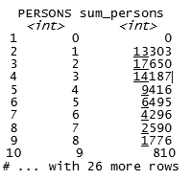
Accidents with x amount of people involved
accident1 <- tbl_df(accident)
accident1 %>%
group_by(PERSONS) %>%
summarize(sum_persons = sum(PERSONS, na.rm = TRUE))

Slide 6
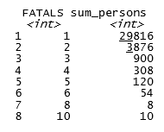
Number of fatalities with x amount of people
accident2 <- tbl_df(accident)
accident2 %>%
group_by(FATALS) %>%
summarize(sum_persons = sum(FATALS, na.rm = TRUE))

Slide 7
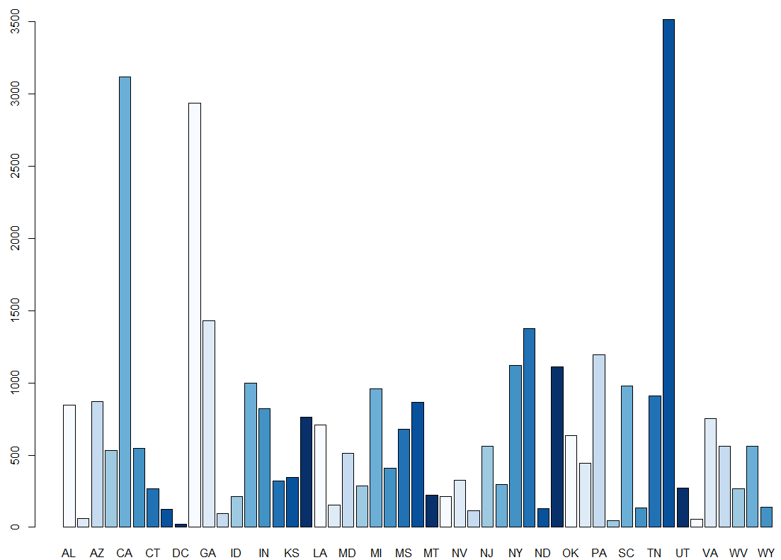
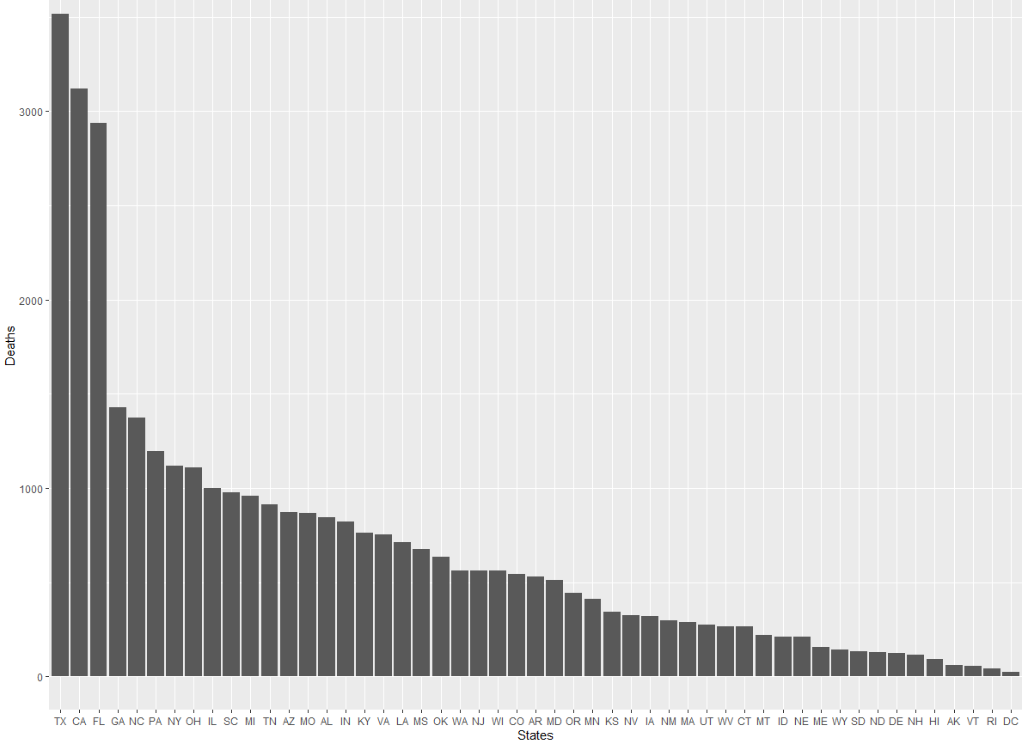
Data Cleaning and Fatalities per State
#remove '99' from hour column
accident_hour <- filter(accident, HOUR <24)
accident_hour1 <- na.omit(accident_hour)
Ggplot()
sum1$STATE_NAMES <- c("AL", "AK", "AZ", "AR", "CA", "CO", "CT", "DE", "DC", "FL", "GA",
"HI", "ID", "IL", "IN", "IA", "KS", "KY", "LA", "ME", "MD", "MA",
"MI", "MN", "MS", "MO", "MT", "NE", "NV", "NH", "NJ", "NM", "NY",
"NC", "ND", "OH", "OK", "OR", "PA", "RI", "SC", "SD", "TN", "TX",
"UT", "VT", "VA", "WA", "WV", "WI", "WY")
Notes:
Group_by STATE
Data labels added manually

Slide 8
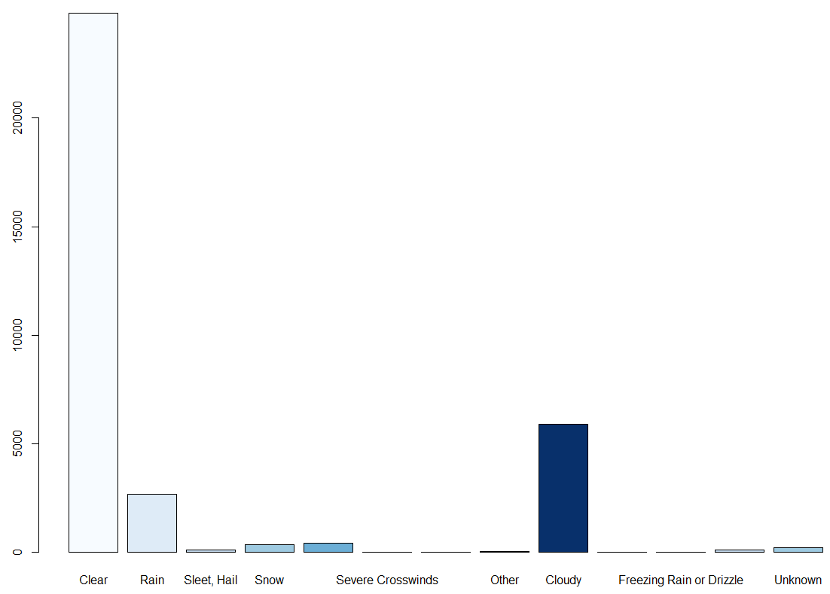
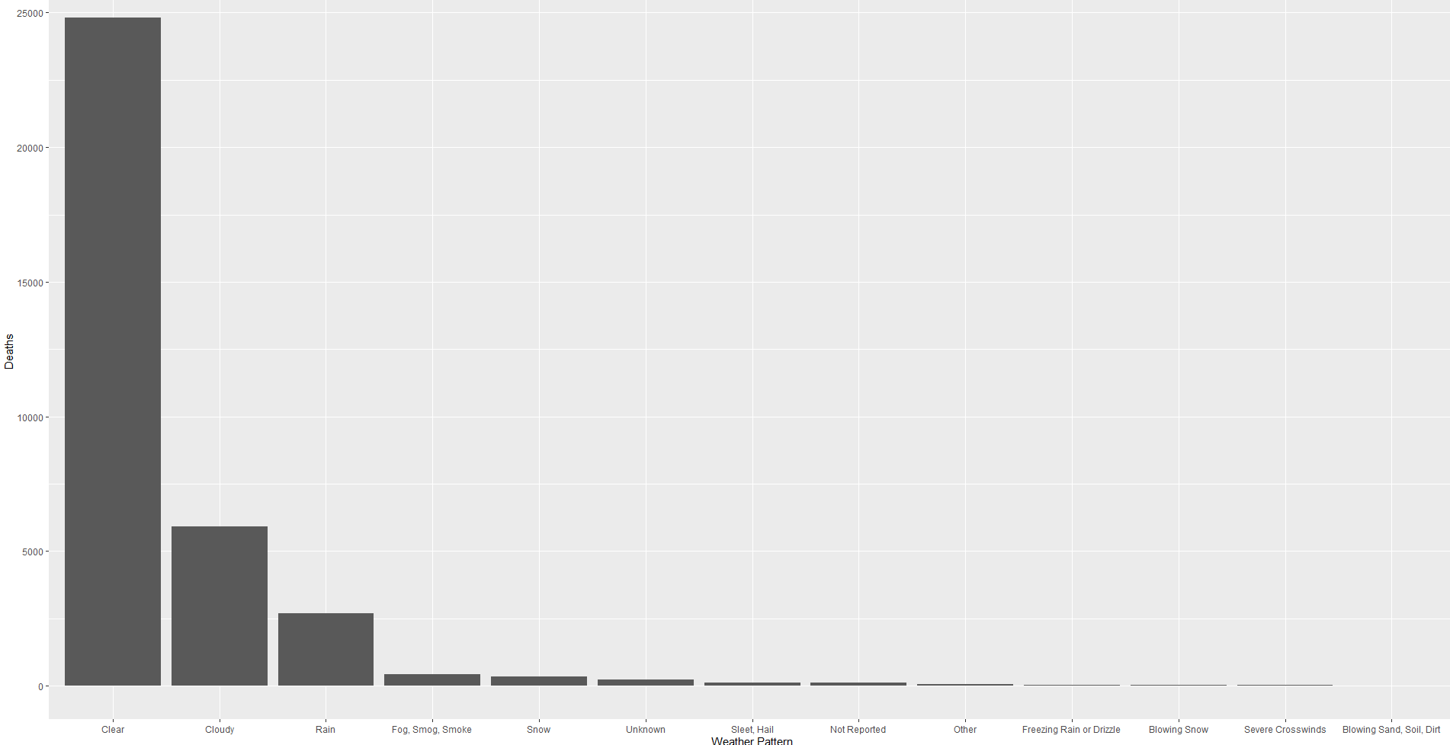
Weather Effects on Fatalities
sum2$weather_pattern <- c('Clear',
'Rain',
'Sleet, Hail',
'Snow',
'Fog, Smog, Smoke',
'Severe Crosswinds',
'Blowing Sand, Soil, Dirt',
'Other',
'Cloudy',
'Blowing Snow',
'Freezing Rain or Drizzle',
'Not Reported',
'Unknown')
Notes:
Group_by weather

Slide 9
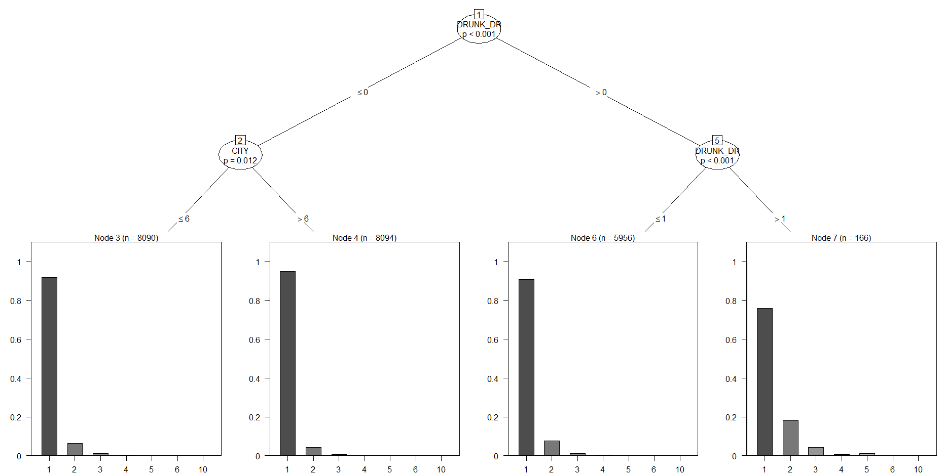
Classification Model - Fatalities
STATE
CITY
DAY OF THE WEEK
NHS
ROAD SYSTEM
DRUNK DRIVER
crash_ctree <- ctree(myf, data = train.data)
table(predict(crash_ctree), FATALS)
Notes:
Nhs whether it’s a national highway system
Recursive partitioning for continuous, censored, ordered, nominal and multivariate response variables in a conditional inference framework.

Slide 10
Conclusions
Almost as many accidents are single vehicle crashes as those that are two-vehicle crashes
Almost 30,000 accidents involved only one death whereas only less than 4000 crashes lead to two deaths
Counter to the fact that there are more two-vehicle crashes
Unlikely for fatalities of both parties
California, Texas and New York are the three most populous states
New York is only 7th in fatalities, can be attributed to other modes of transportation
Most accidents happen in clear weather conditions, counterintuitive to expectations
Finally, when looking at the classification by decision tree, the model was unable to successfully predict the number of fatalities given the attributes used. This may be due to the fact that some of the attributes were categorical

Slide 11
End

Slide 12
Distractions

